Slide 1

Michael Ochs, MVP
Mallory Lawhorne
Build a Line of Business App with Power Platform

Slide 2


Slide 3

Line of Business Process
Employee Submits Time off Request
Canvas App
Manager Approves / Declines Request
Flow Approval
Scheduler Approves / Declines Request
Model Driven App
Scheduler Creates Schedule
Vacation Approved?

Slide 4
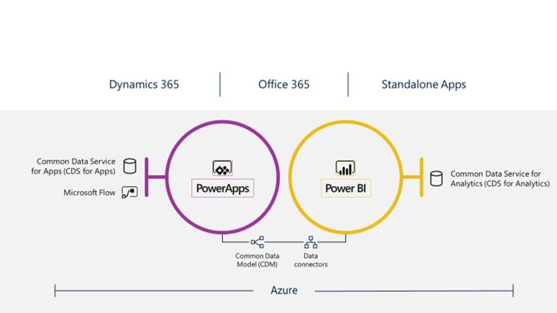
Power Platform

Slide 5
DEMO

Slide 6


